Slide 1

Android: Events and Intents
LEIM – DAM

Slide 2
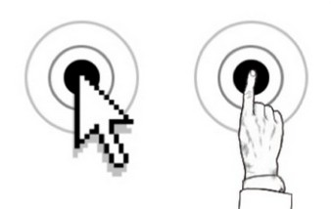
Events
User interacts with the application to perform specific tasks
Each action the user takes with the application triggers an Event
For example: click, tap, key, …
The application captures the event and responds through a specific behavior

Slide 3
Event Management (I)
Each action is performed on a specific interface element
Example: click on a button element
View is responsible for managing the event
Button element when it receives the click, initiates the event management process

Slide 4
Event Management (II)
Callback Method
Each View class provides public methods to manage interaction with the user, e.g. Onclick (...), OnTouch (…)
EventListeners
View element delegates the responsibility of managing the event to EventListeners objects

Slide 5
“Callback” Methods
OnKeyDown(int, KeyEvent)
Occurs when a key is pressed
OnKeyUP(int, KeyEvent)
Occurs when a key is released after being pressed
OnTrackballEvent(MotionEvent)
Occurs when trackball movement
OnTouchEvent(MotionEvent)
Occurs when there is a touch on the screen

Slide 6
“Callback” Methods: Advantages and Disadvantages
Using callback methods involves extending the View class (e.g., button) and redefining the methods
Advantages
Useful for when we want to create a new button derived from the existing button class
Disadvantages
Not very practical because it is necessary to extend to each View object

Slide 7

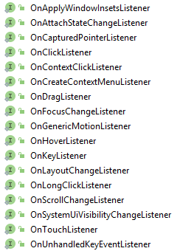
EventListeners: Interfaces
The View class defines EventListeners interfaces to process specific events
On the right it is the list of those EventListeners

Slide 8
EventListeners: Event Management
Implement an EventListener interface
Register the EventListener object in the View
private OnClickListener mlist = new View.OnClickListener() {
@Override
public void onClick(View v) {
…
}
});
slbIcon = (ImageButton) this.findViewById(R.id.slbIcon); slbIcon.setOnClickListener(mlist);

Slide 9
EventListeners: Alternative Way
// Anonymous implementation of OnclickListener
slbIcon = (ImageButton) this.findViewById(R.id.slbIcon); slbIcon.setOnClickListener(new View.OnClickListener() {
@Override
public void onClick(View v) {
…
}
});
or
private OnClickListener mlist = new View.OnClickListener() {
@Override
public void onClick(View v) {
…
}
});
protected void onCreate(Bundle savedInstanceState) {
slbIcon = (ImageButton) this.findViewById(R.id.slbIcon); slbIcon.setOnClickListener(mlist);
…
}

Slide 10
EventListeners: Anonymous Implementation
Advantages
Allows better integration of objects
Disadvantages
Repetition of the code (almost equal when applied to more than one control)

Slide 11
EventListener: MainActivity Implements the Interface (I)
// MainActivity implements the interface
public class MainActivity extends AppCompatActivity implements View.OnClickListener {
protected void onCreate(Bundle savedInstanceState) {
…
Button b = (Button) this.findViewById(R.id.bsoma);
assert b != null : "setupButtons: button bsoma is not valid";
b.setOnClickListener(this);
}
public void onClick(View v) {
Button b = (Button)v;
…
}
}

Slide 12
EventListeners: MainActivity Implements the Interface (II)
Advantages
Better integration with the rest of the code, allows to maintain good structure
Disadvantages
You can not pass arguments to the EventListener
More difficulty when different controls use the same event

Slide 13
Event Management in XML (I)
<?xml version="1.0" encoding="utf-8"?>
<LinearLayout
xmlns:android="http://schemas.android.com/apk/res/android"
android:layout_width="wrap_content"
android:layout_height="wrap_content">
<Button
android:text="Show Me!"
android:id="@+id/btnShowMe"
android:layout_width="wrap_content"
android:layout_height="wrap_content"
android:onClick="showMe" />
</LinearLayout>

Slide 14
Event Management in XML (II)
public class MainActivity extends Activity {
public void onCreate(Bundle savedInstanceState) {
super.onCreate(savedInstanceState);
setContentView(R.layout.eventhandling);
}
public void showMe(View v){
Toast.makeText(this, "This event invoked from XML.", Toast.LENGTH_SHORT).show();
}
}
We have to implement the method that is called to react to the event

Slide 15
Events using XML
Advantages
Just need to implement the method that responds to the event
Does not implement the EventListener interface
Allows you to use different methods for different input controls
Disadvantages
Only for the OnClick event
Can not pass arguments
Less clear to the programmer what method for each View

Slide 16
EventListeners: Examples
EventListener | Callback Methods | Description
View.OnClickListener | OnClick | Occurs when the user clicks on the interface elements
View.OnLongClickListener | onLongClick | Occurs when the user clicks and holds the element
View.OnFocusChangeListener | OnFocusChange | Occurs when the user navigates out of the element
View.OnKeyListener | OnKey | Occurs when the focus is on the element (View) and the user presses or releases a key
View.OnTouchListener | OnTouch | Occurs when the user performs a qualified action as a touch, including pressing, releasing, or any gesture on the screen

Slide 17
Intents

Slide 18
Intents
Messages between Components and Applications
Asynchronous messages that allow Android components to make requests for features to other system components
Activity can send Intents to the system starting another Activity
Intents can contain data that can be used by the component that receives the Intent
types of Intents:
Explicit
Implicit

Slide 19
Intents: Explicit
Explicitly define the component that must be called by the system to receive the intent
send an intent to known component
Intent intent = new Intent(MainActivity.this, DetailsActivity.class);
startActivity(intent);

Slide 20
Intents: Implicit
Define an action that can be performed by any component, in the device, capable of performing the action
Must be used when the app we are developing can not perform an action but another app probably can
// Ask the system to view a Web page
Intent intent = new Intent(Intent.ACTION_VIEW, URI.parse(“http://www.google.com”));
// Ask the system to open the video camera
Intent intent = new Intent(android.provider.MediaStore.ACTION_IMAGE_CAPTURE);

Slide 21
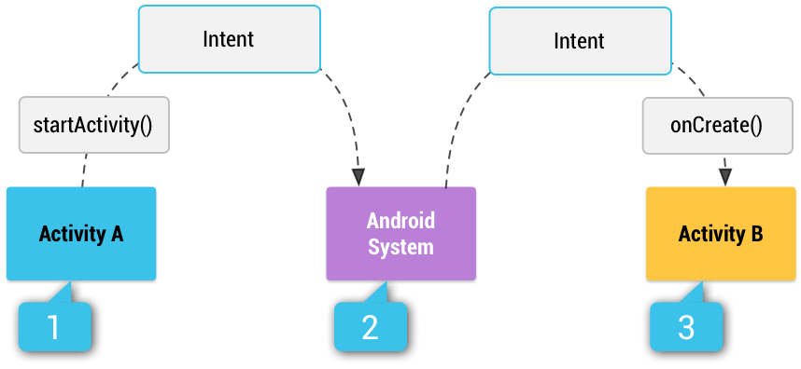
Intents: Implicit (Example)
Activity A creates an Intent with an action description and passes it to startActivity()
The Android System searches all apps for an intent filter that matches the intent. When a match is found…
The system starts the matching activity (Activity B) by invoking its onCreate() method and passing it the Intent

Slide 22
Intents: can carry data
Intent can carry data
Items kept is pairs: key, value
Value can be of primitive type, array, or ArrayList (String or Integer)
Intents data are limited in size
Intent intent = new Intent()
intent.putExtra("key1", 1);
intent.putExtra("key2", "hello");
intent.putExtra("key3", new char [] {‘a’,’b’});
Bitmap image;
. . .
intent.putExtra("image", image);

Slide 23
Intents: Getting Data
Getting data from the Intent
The methods to get data are typified (in the name and return value)
Bundle extras = getIntent().getExtras();
if(extras != null) {
int val1 = extras.getInt("key1");
String val2 = extras.getString("key2");
char[] val3 = extras.getCharArray("key3");
Bitmap bitmap = extras.getParcelableExtra("image");
}

Slide 24
Intents: Starting Activities
Calling/starting Activities
Intent defines the targer activity
Intent can carry data
More about starting activities at the end
// public Intent(Context packageContext, Class<?> cls)
// Starts/calls DetailsActivity
Intent intent = new Intent(MainActivity.this, DetailsActivity.class);
intent.putExtra(...);
...
startActivity(intent);

Slide 25
Intent Object
Contains information for the component that receives the Intent and for the system
Name of the component that will process the Intent
Action that needs to be performed
Data that an action needs to be performed
Type of data
Category of the processing required
Flags needed to refine processing to be done

Slide 26
Implicit Intent Resolution
How does Android find the best component?
Compares the content of the Intent object with the Intent filters of each component
Action
Data (URI e data type)
Category
The Intent object information relative to the three elements is compared to the intent filters of each component defined in the ManifestAndroid file

Slide 27
Implicit Intent: “Action” Test
Intent Object | Components (intent-filter)
No Actions defined | All the components with at least one Action defined pass the test
Actions defined | No Actions defined will fail the test
Actions defined | All Actions must be in the intent-filter to pass the test
<intent-filter . . . >
<action android:name="dam_a60000.project.SHOW_CURRENT"/>
<action android:name="dam_a60000.project.SHOW_RECENT"/>
<action android:name="dam_a60000.project.SHOW_PENDING"/>
. . .
</intent-filter>

Slide 28
Implicit Intent: “Category” Test
Intent Object | Components (intent-filter)
No Categories defined | All the components will pass the test
Categories defined | All Categories must be defined to pass the test
<intent-filter . . . >
<action android:name="android.intent.category.DEFAULT"/>
<action android:name="android.intent.category.BROWSABLE"/>
. . .
</intent-filter>

Slide 29
Implicit Intent: “Data” Test
Intent Object | Components (intent-filter)
No Data defined | All the components with no Data defined will pass the test
Data defined | All the components with the same type of Data defined will pass the test
<intent-filter . . . >
<data android:mimeType="video/mpeg"
android:scheme="http" ... />
<data android:mimeType="audio/mpeg"
android:scheme="http" ... />
. . .
</intent-filter>

Slide 30
Starting activities

Slide 31
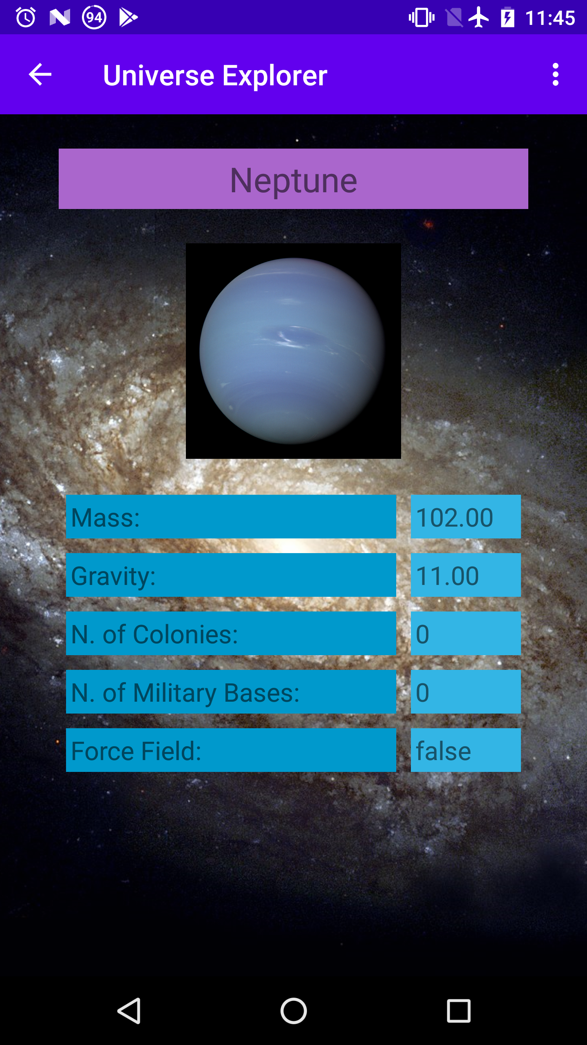
Starting Activities
Calling/starting Activities
Started activities can get data from intente, as seen
Ending Activities
By pressing the Android Back button
By invoking: finish();
// public Intent(Context packageContext, Class<?> cls)
Intent intent = new Intent(MainActivity.this, DetailsActivity.class);
// intent.putExtra(...);
startActivity(intent);

Slide 32
Starting Activities that can return results
Calling/starting Activities that can return results
We must pass a code that identifies the call
Receiving the return value: when the activities finishes, the original activity receives a callback on onActivityResult method, with:
the requestCode used, the resultCode and the result data
Result code may be: Activity.RESULT_OK or Activity.RESULT_CANCELED, or any positive value
Pressing the Android Back button results in Activity.RESULT_CANCELED resultCode
// public void startActivityForResult(Intent intent, int requestCode)
int ResultActivityRequestCode = 1;
Intent intent = new Intent(MainActivity.this, ResultActivity.class); // start ResultActivity
// intent.putExtra(...);
startActivityForResult(intent, ResultActivityRequestCode);
// protected void onActivityResult(int requestCode, int resultCode, Intent data)
protected void onActivityResult(int requestCode, int resultCode, Intent intent) { ... Next slide

Slide 33
Getting the result of an Activity
// protected void onActivityResult(int requestCode, int resultCode, Intent data)
protected void onActivityResult(int requestCode, int resultCode, Intent intent) { super.onActivityResult(requestCode, resultCode, intent); Log.d(LOG_MSG, "On onActivityResult, requestCode: " + requestCode
+ " , resultCode: " + resultCode); // if ResultActivity if (requestCode == ResultActivityRequestCode) { if (resultCode == RESULT_OK) { // if OK return code Bundle extras = intent.getExtras(); Objects.requireNonNull(extras); Log.d(LOG_MSG, "On onActivityResult bundle: " + extras.toString());
. . .
}
if (resultCode == RESULT_CANCELED) { // if CANCELED return code . . .
}
}
}

Slide 34
Finishing Activities
Intersecting Android back button
Finish an Activity with success or failure and results
public void onBackPressed() {
// as an example: if data not saved, do not leave the activity if (!isDataSaved()) Toast.makeText(PlanetActivity.this, "Nope. Save state first!", Toast.LENGTH_SHORT).show(); else { // finish with success (or failure) } }
// public void setResult(int resultCode, Intent data) or: setResult(int resultCode)
Intent intent = new Intent(); intent.putExtra(...); setResult(RESULT_OK, intent); // or setResult(RESULT_CANCELED); finish();

Slide 35
Back Action Bar button
To add a Back Action Bar button
To intersect Back Action Bar button pressed
// add back button to action bar, on onCreate
// an AppCompatActivity should have an action bar Objects.requireNonNull(getSupportActionBar()).setDisplayHomeAsUpEnabled(true);
public boolean onOptionsItemSelected(MenuItem item) { switch (item.getItemId()) {
case android.R.id.home: // as an example: if data not saved, do not leave the activity if (!isDataSaved()) Toast.makeText(this, "Nope. Save state first!", Toast.LENGTH_SHORT).show(); else { // finish with success (or failure) } break;
...
default: return super.onOptionsItemSelected(item); } return true; }

Slide 36
Bibliography
Input Events
Intents

